Slide 1
Predicting Exchange Rate
Prasanti Das
Time Series Analysis
Aug 2018

Slide 2
About Project
Goal :-
Develop a model which will help investors and business owners to decide about their investment opportunities across globe.
Benefits:-
Maximize their profit
Manage the cash flow and take business expansion decisions
Helps to evaluate foreign borrowing decisions , investment opportunities
Minimize the risk

Slide 3
About the Data
The data set represents
Exchange Rate Analysis from INR to USD
Daily exchange rate information from the year 1973 till date
The data source is https://fred.stlouisfed.org

Slide 4
Data Cleaning
Missing values
458 missing values in this dataset
Used a forward-fill to propagate the previous value to next observation.
Other:
• Given appropriate column name
• Changed the datatype of Date column from object to datetime
• Set the Date column as Index
• Changed the datatype of Exchange Rate column from object to numeric.

Slide 5
Exploratory Data Analysis

Slide 6
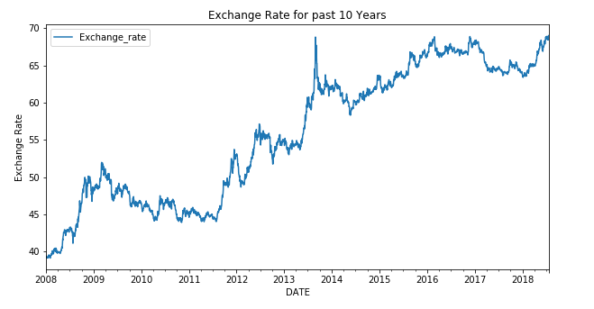
Exchange Rate for past 10 years
The exchange rates shows volatility, but illustrates an overall increasing trend.

Slide 7
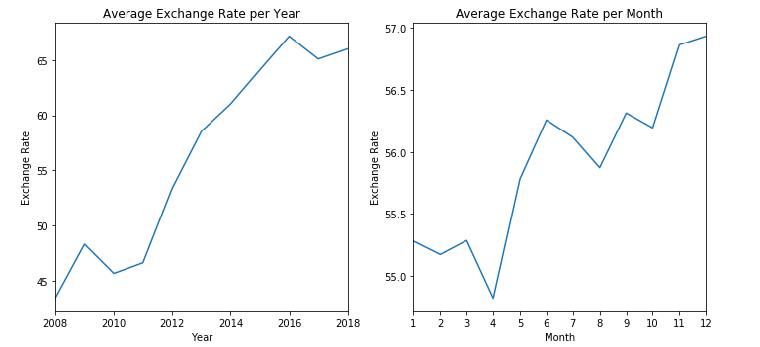
Average Exchange Rate per year and Month
There is no seasonality, but we see an upward trend.

Slide 8
Decomposition

Slide 9
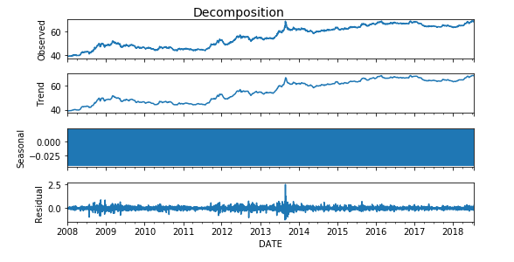
Decomposition
Decomposed the time series data to find patterns of Seasonality, Trend.

Slide 10
Modelling

Slide 11
Model Assumption and preprocessing:
Important Assumption :
Time Series Data is Stationary
Stationary:
Mean, variance and autocorrelation does not depend on time.
How to check stationarity ?
Plotting Rolling Statistics
Augmented Dickey-Fuller Test
How to achieve stationarity?
First or second order difference
Different transformation

Slide 12
Augmented Dickey-Fuller (ADF) test
Used to test for a unit root in a time series sample.
Null hypothesis : there is a unit root,
alternative hypothesis : there is no unit root.
Interpretation of ADF Test result:
p-value > 0.05:
Accept the null hypothesis (H0),
the data has a unit root and is non-stationary.
p-value < 0.05:
Reject the null hypothesis (H0),
the data does not have a unit root and is stationary.

Slide 13
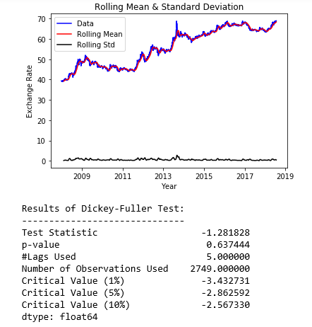
ADF test – Actual Data
P value is more than 0.05
TS is not Stationary

Slide 14
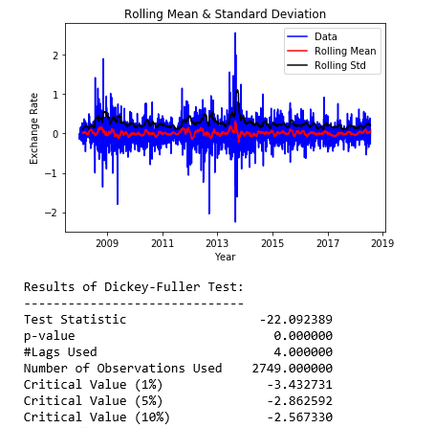
ADF test – Differenced Data
P value is less than 0.05
TS is Stationary

Slide 15
ACF and PACF
ACF
Autocorrelation Function:
Measure of the correlation between the Time series with a lagged version of itself.
PACF
Partial Autocorrelation Function:
Measures the correlation between the Time series with a lagged version of itself, but after eliminating the variations already explained by the shorter lags.

Slide 16
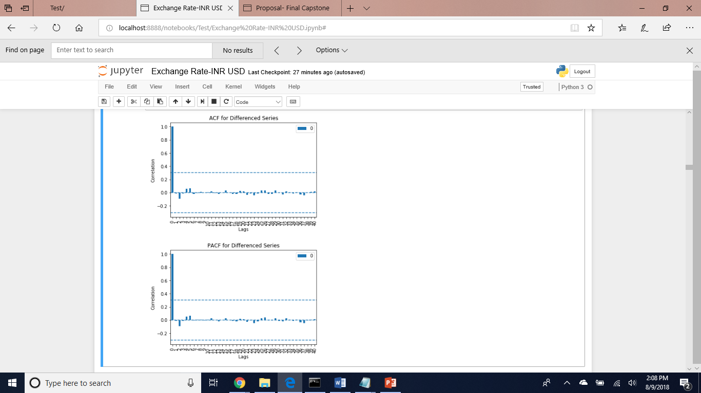
ACF and PACF plot
No significant lags.

Slide 17
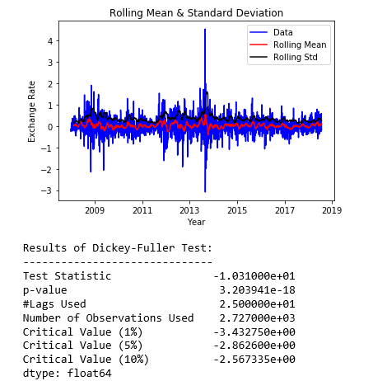
ADF test – Differenced Data
Stationary
P value is less than 0.05

Slide 18
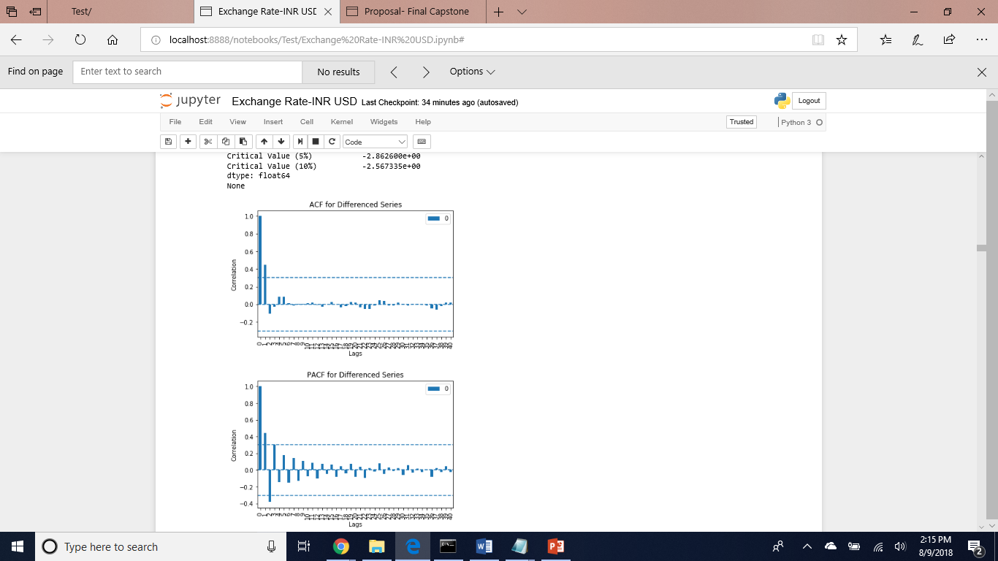
ACF and PACF plot
ACF plot suggests MA of order 1
PACF plot suggests AR of order 2 or 3

Slide 19
ARIMA Modelling
Enables to use linear regression models on non-stationary data.
AR (Autoregression):
Uses the relationship between an observation and it’s lagged observations.
I (Integrated):
Order of differencing of observations to make the time series stationary.
MA (MovingAverage):
Uses the dependency between an observation and past error.

Slide 20
ARIMA Modelling
Denoted with the notation ARIMA(p, d, q)
p : Number of AR terms
d : the degree of differencing.
q : Number of MA terms
Tried Grid search on
p – 0,1,2,3
d – 0,1,2
q - 0,1,2,3

Slide 21
Train Test Split and Evaluation
Split:
The last 90 observations as the test data and remaining as training data
AIC:
Akaike information criteria : provides a way of model selection.
MSE:
Mean squared error
Validation:
walk-forward model validation

Slide 22
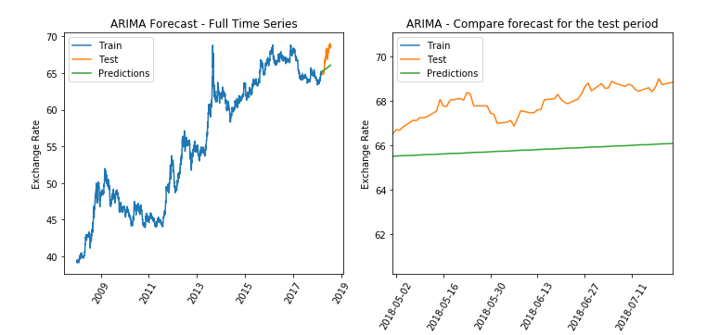
ARIMA Best Model - Prediction
Lowest MSE
Best Model Chosen by ARIMA- 1,1,0
AIC: 940.7
MSE: 3.33

Slide 23
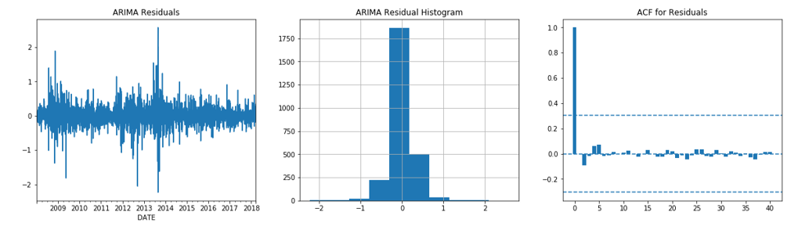
ARIMA Best Model - Residual
The residuals appear to be normally distributed and the ACF plot for residuals also don’t show any significant lag values.

Slide 24
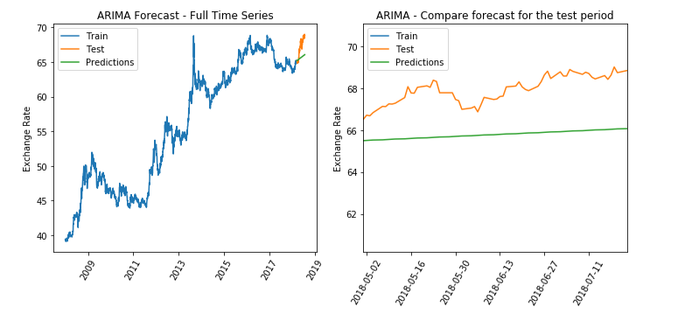
ARIMA Best Model - Prediction
Lowest AIC
Best Model Chosen by ARIMA- 2,1,2
AIC: 907.2
MSE: 3.37

Slide 25
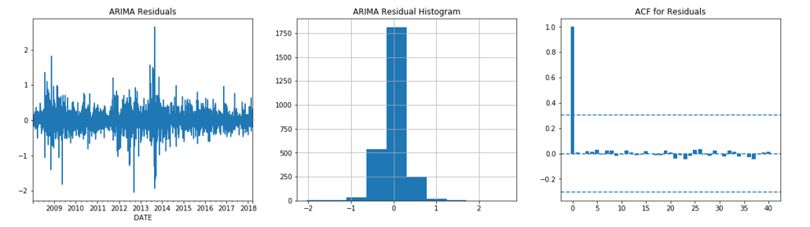
ARIMA Best Model - Residual
The residuals appear to be normally distributed and the ACF plot for residuals also don’t show any significant lag values.

Slide 26
AUTO ARIMA Modelling
Wraps statsmodels’ well-tested ARIMA and SARIMAX estimators in a single, easy-to-use package
Uses pyramid-arima library for Python
allows to quickly perform grid search
Installation Requirement :
pyramid-arima should be installed
Other Parameters:
m : The period for seasonal differencing.
seasonal : Whether to fit a seasonal ARIMA. Default is True.
stepwise : less likely to over-fit the model.

Slide 27
Auto ARIMA Modelling - Result
Grid Search Parameters
P = 0,1,2
D = 0,1
Q = 0,1,2
m = 1,7,30
p = 0,1,2,3
d = 0,1,2
q = 0, 1,2,3
Best Configuration: (2, 1, 0)
AIC : 976.28
MSE : 3.39

Slide 28
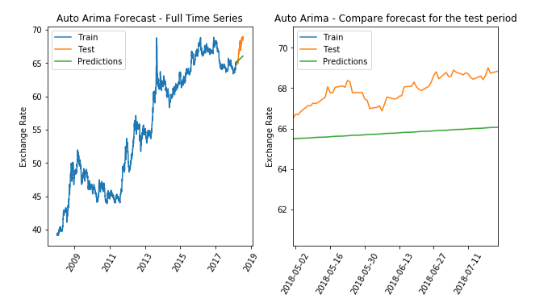
Auto ARIMA Best Model - Prediction

Slide 29
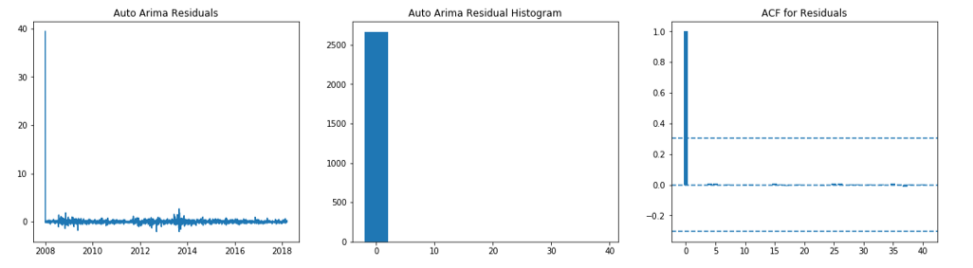
Auto ARIMA Best Model - residual
The residuals appear to be normally distributed and the ACF plot for residuals also don’t show any significant lag values.

Slide 30
Prophet Model
• Developed by Facebook for forecasting time series data.
• Based on an additive model
• Non-linear trends are fit with yearly, weekly, and daily seasonality, plus holiday effects.
• Works best with time series that have strong seasonal effects and several seasons of historical data.
• Robust to missing data and shifts in the trend, and typically handles outliers well.

Slide 31
Prophet Model
Installation Requirements:
Need pystan, cython and fbprophet modules installed .
Input Requirements:
• Requires specific input format.
• Columns names must be lowercase,
• date column should be named as 'ds', data as 'y'

Slide 32
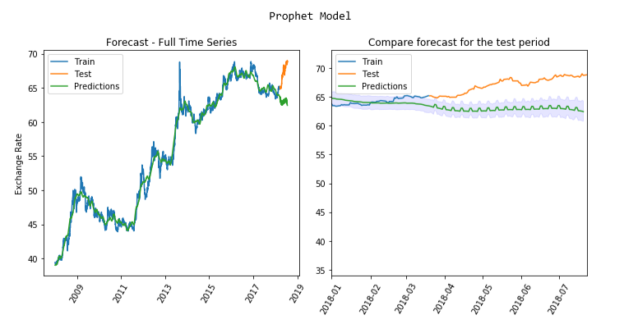
Prophet Model - prediction
Prophet Model
(Default parameters)
MSE : 1.43

Slide 33
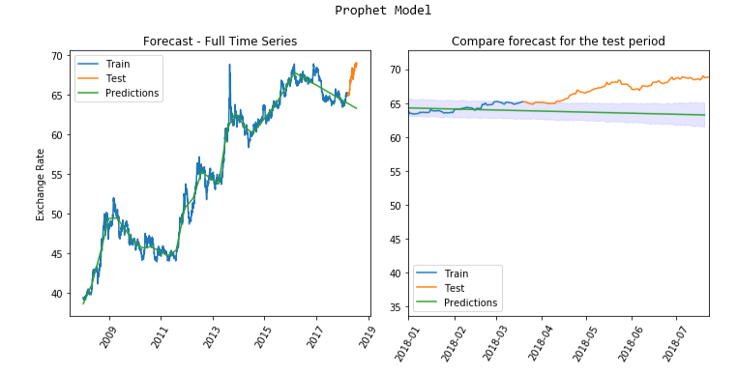
Prophet Model - prediction
Prophet Model
(parameter tuning)
Daily, weekly and yearly seasonality=False
MSE : 1.39

Slide 34
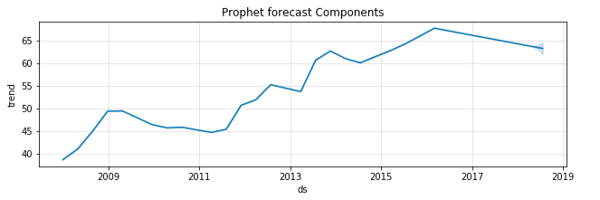
Prophet Model – forecast components
Prophet forecast a decreasing Trend

Slide 35
LSTM network
Stands for Long Short-Term Memory Network
A recurrent neural network
Trained using Backpropagation Through Time
Overcomes the vanishing gradient problem

Slide 36
Preprocessing - LSTM
Sensitive to the scale of the input data
Took last 90 observations as test data and rest as training data
Needs input in the form of: [samples, time steps, features]
Wrote a simple function to convert our single column of data into a multi-column dataset and consider the last column as dependent variable.

Slide 37
LSTM Model
Fitted a Model with 1 input layer, 1 hidden layer with 4 LSTM blocks, and 1 output layer
default sigmoid activation function is used for the LSTM blocks.
Dropout – for addressing overfitting problem
The network is trained for 100 epochs and a batch size of 64.

Slide 38
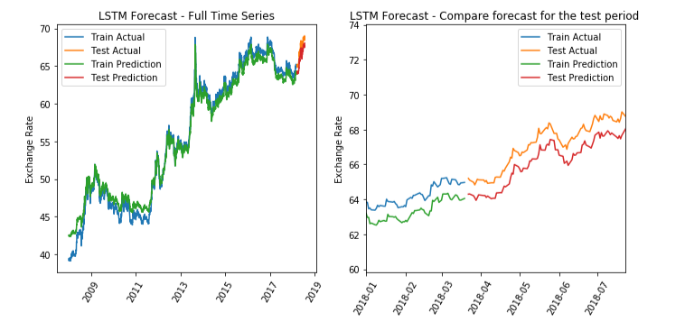
LSTM network – Prediction – 1 day Look Back
Look back of 1 day data- MSE = 0.98

Slide 39
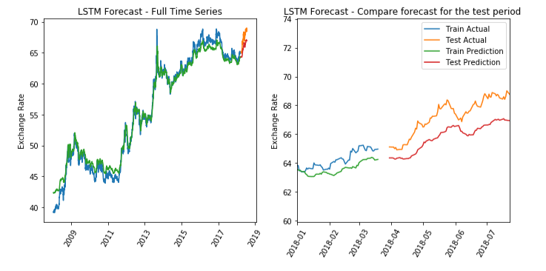
LSTM network – Prediction – 7 days Look Back
Look back of 7 days data- MSE = 2.3

Slide 40
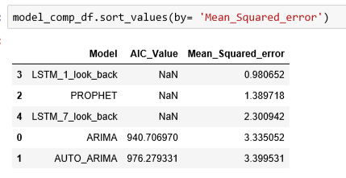
Model Comparison – Using MSE
The LSTM model with 1 day look back, provided the lowest mean squared error

Slide 41
Conclusion
We looked at a large range of ARIMA configurations as well as a more powerful forecasting tool developed by the Facebook. We also looked at the LSTM Neural Network model. All of the models did fairly well.
Model improvements:
For prophet – adding Holiday calendar
For LSTM models - try parameter tuning and adding More layers

Slide 42
THANK YOU

Slide 43
Questions

